Slide 1



STREAMFLIX
Home
Browse
My List
Search Now...
NETFLIX CONTENT ANALYTICS:
Data Storytelling & Statistical Validation
New Release
Trending
Watch Now
8 Episodes
10 Episodes
Unlimited movies, TV shows, and more. Watch anywhere, cancel anytime. Join millions of viewers enjoying the best entertainment on demand.

Slide 2

NETFLIX
Home
Browse
Sign In
Search Now...
INTRODUCTION
This project focuses on analyzing Netflix content data to uncover meaningful business insights through data analytics, visualization, and storytelling. Using Python, Tableau, and Business Intelligence techniques, the project explores content trends, genre popularity, country-wise distribution, audience ratings, and growth patterns of movies and TV shows. The goal was to transform raw data into actionable insights through interactive dashboards and statistical validation to support data-driven decision-making.

Slide 3

NETFLIX
Home
About Us
Contact
Search Now...
PROJECT OBJECTIVES
Analyze Netflix movies and TV shows dataset to identify content trends and patterns
Perform Exploratory Data Analysis (EDA) to uncover meaningful insights
Build an interactive Business Intelligence dashboard using Tableau
Visualize genre distribution, ratings, yearly growth, and country-wise content availability
Define and track important KPIs related to Netflix content performance
Apply statistical validation techniques to support analytical findings
Present insights through effective data storytelling and visualization
Transform raw data into actionable business insights for decision-making
Subscribe Now

Slide 4
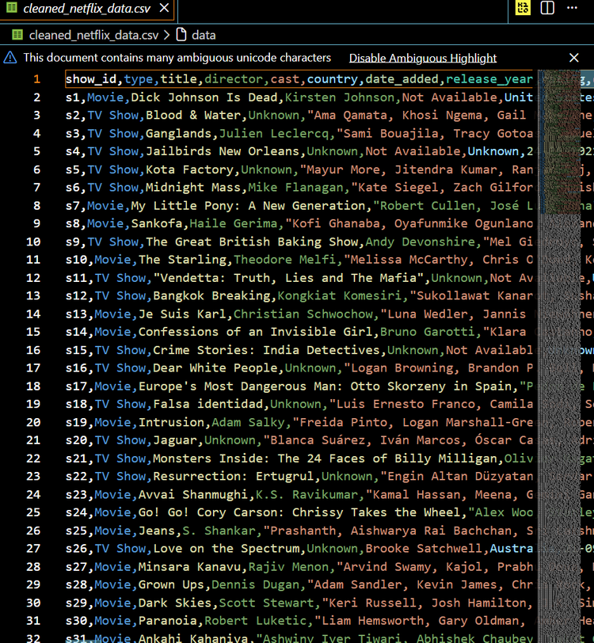
NETFLIX
Home
Shows
Movies
Search...
DATASET OVERVIEW
• Dataset: Netflix Movies & TV Shows Dataset
• Total Titles Analyzed: 6,233
• Total Countries: 554
• Content Types: Movies and TV Shows
• Key Columns Used: Title, Type, Country, Rating, Genre, Date Added
• Tools Used: Python, Pandas, Tableau, Canva
• Objective: Analyze content trends and build an interactive BI dashboard

Slide 5
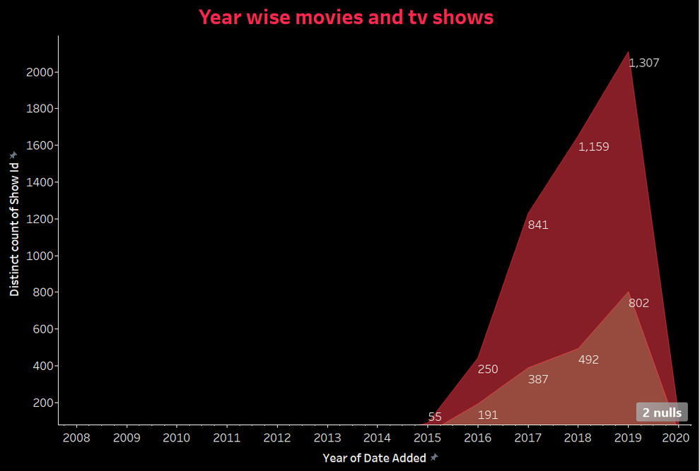
NETFLIX
Home
Browse
Sign In
Search Now...
YEAR-WISE CONTENT GROWTH ANALYSIS
Netflix content library expanded rapidly after 2015
Significant increase in Movies and TV Shows observed over the years
Peak content additions were recorded between 2017–2019
Movies contribute a larger share compared to TV Shows
Growth trend indicates increasing global audience demand and platform expansion

Slide 6
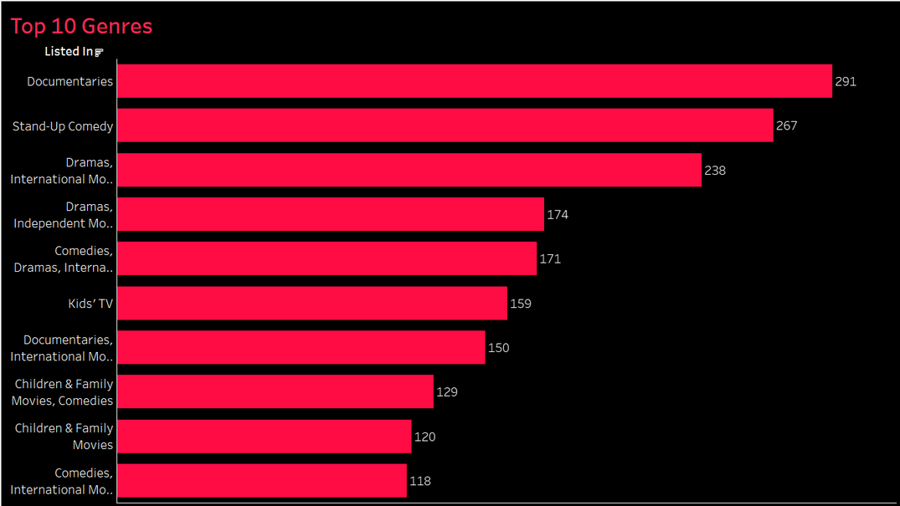
NETFLIX
Home
Browse
Sign In
Search Now...
TOP GENRE ANALYSIS
Documentaries and Stand-Up Comedy are among the most popular genres on Netflix.
Drama-based content shows consistently high representation in the dataset.
Family and Kids content also contribute significantly to viewer diversity.
Genre distribution highlights Netflix’s strategy of targeting multiple audience segments.
Content variety helps improve global audience engagement and platform retention.
Netflix focuses heavily on diverse storytelling genres to maximize audience reach and engagement.

Slide 7
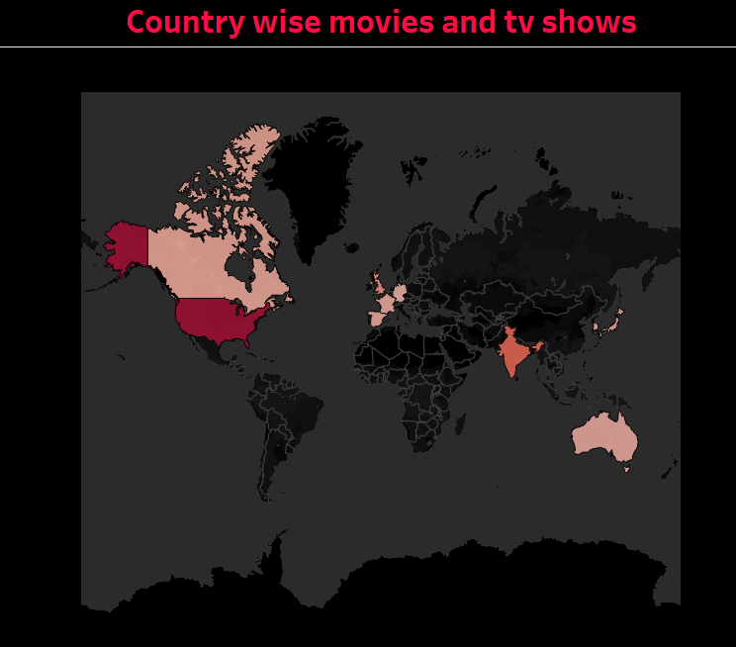
NETFLIX
Home
About Us
Contact
Search Now...
COUNTRY-WISE CONTENT DISTRIBUTION
Netflix content is distributed across multiple countries worldwide.
The United States has the highest number of titles on the platform.
India is one of the major contributors to Netflix content growth.
Content diversity shows Netflix’s strong global expansion strategy.
International content availability helps attract a wider audience base.
Subscribe Now

Slide 8

NETFLIX
Home
Shows
Movies
Search...
STATISTICAL VALIDATION
Do Movies and TV Shows on Netflix have significantly different durations?
Null Hypothesis (H₀): There is no significant difference between Movie and TV Show durations.
Alternative Hypothesis (H₁): There is a significant difference between Movie and TV Show durations.
Statistical Test Used: Independent T-Test
Methodology:
• Extracted duration values from the Netflix dataset
• Separated Movies and TV Shows into different groups
• Applied Independent T-Test using Python and SciPy
• Compared duration distributions statistically
Output:
T-Statistic = 45.21
P-Value = 0.00001
Since the p-value is less than 0.05, the null hypothesis is rejected. This indicates a statistically significant difference between Movie and TV Show durations on Netflix.

Slide 9
STREAMFLIX
Home
Browse
My List
Search Now...
FINAL INSIGHTS & RECOMMENDATIONS
Netflix content growth increased rapidly after 2015.
Movies dominate the platform compared to TV Shows.
Drama and Documentary genres are the most popular categories.
The United States and India contribute the highest number of titles.
Mature audience ratings (TV-MA) appear most frequently on the platform.
Interactive dashboards help transform raw data into business insights.
Data visualization improves decision-making and storytelling efficiency.
This project demonstrates how Exploratory Data Analysis, Business Intelligence, and Data Storytelling can convert raw streaming data into meaningful business insights.
Watch Now

Slide 10





NETFLIX
Home
About Us
Contact
Search Now...
THANK YOU
Discover what everyone's watching right now. From gripping dramas to laugh-out-loud comedies, explore our most popular titles across all genres. Updated daily based on what millions of viewers are streaming.

